Slide 1
Solar and Alternative Energies
Dr. Stephen M Jarrett
President
Dolphin & Eagle Consulting, Inc.
Charleston, SC

Slide 2
Advanced Technology Solutions
Maximizing existing system efficiencies
Providing customers with technology alternatives
Utilizing technology to reduce waste energy loss
Reducing waste gas emissions
Leading edge technology solutions and analysis

Slide 3
Analysis of Alternatives
Design and installation of solar systems
Wind generation systems
Design and installation of net metering alternative energy systems
Wind exhaust recovery systems
Waste heat recovery systems
Natural Gas direct electrical mini turbines as user backup electrical systems
Gas letdown generation systems
Consulting on emerging technology developments critical to the future of the low country.

Slide 4
Charleston office through Dolphin & Eagle
Have a number of installed systems in Georgia, Florida and Alabama, just opened office in SC.
Designers trained through Solairgen, Inc. in Dahlonega, Ga. Nationally certified
Installs Industrial and residential systems.
Proposed 23 solar/diesel/battery systems for Afghanistan for SPAWAR.

Slide 5
Sun Path Chart for 32 d 50m N

Slide 6
North Charleston, City Hall
100 ft
200 ft
N
S
Wind turbines

Slide 7
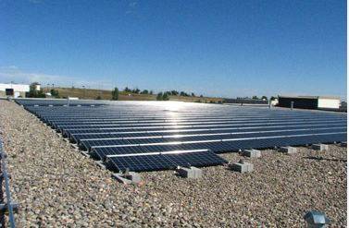
Solar Systems
Attic Breeze Solar Attic fans
OnGrid/Off Grid
Battery backup
Net metering
Micro Inverter or panel group
Mounts or ballasted systems
Ground mounted arrays
Ballasted roof arrays
Track mount arrays

Slide 8
Tax incentives and rebates
http://www.dsireusa.org/

Slide 9
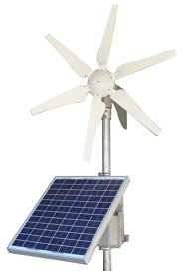
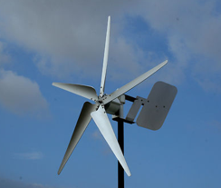
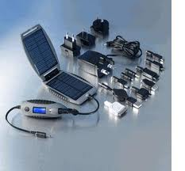
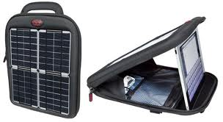
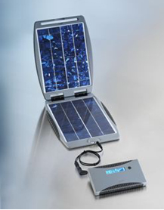
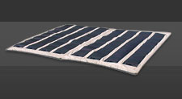
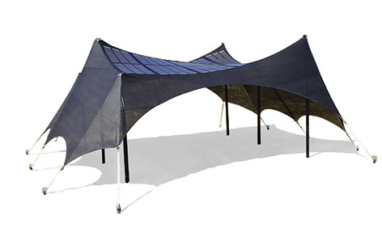
Solar, Wind and Alternative Energy
600w marine
Wind generator
Wind and solar
Combined generator
Laptop and
Handheld electronics
charging
Small Comms
Suite power
system
AA battery charger
Foldable array
62 Watt foldable
array
Foldable array
1kw power shade

Slide 10
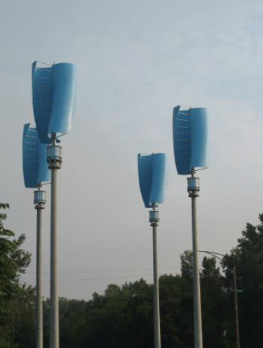
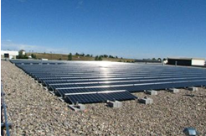
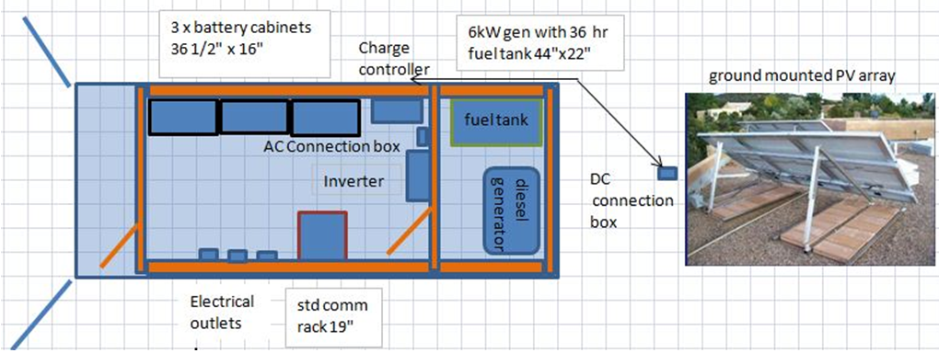
Solar and Hybrid Systems
Wind or hybrid power
Deployable Unmanned Diesel/Battery/Solar self-contained communications unit

Slide 11
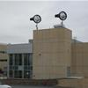
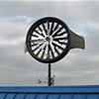
WindTronics Turbines

Slide 12
Exhaust recovery system

Slide 16
An Award Winning System

Slide 17
Turbine Generator Combination

Slide 18
Langson Gas Letdown Generator

Slide 19
Gas Letdown Generators
Langson Energy has developed an exceptionally efficient and unique power conversion system, the Gas Letdown GeneratorTM, which converts Pressure to PowerTM. Vastly more cost effective than turbo expanders, turbines and other alternatives, this will revolutionize the economics of green energy. We can produce base load green power from pressure currently being wasted in gas let down stations, (pressure reduction stations) anywhere a pressure reduction takes place. The current use of JT Valves, (pressure reduction valves) where the pressure is mechanically reduced can now be supplemented with the Gas Letdown GeneratorTM to make power from this energy.

Slide 20
Research and development to lower emissions from Coal.
Current product improves diesel fuel efficiency by 27%
Current product reduces diesel emissions by 90%.
Could improvements in this area greatly reduce emissions from coal?

Slide 23
Biofuel Technology
Methane production from land fills
Santee Cooper generates 28 MW from 7 sites
Ethanol
Biodiesel
Vegetable oil as fuel
Alliances between Shrimp boats and restaurants

Slide 24
Potential Benefits to North Charleston
Emerging technology search and evaluation
Assistance to customers with high usage to reach national renewable goals
Advantages from existing alliances e.g. Windtronics, Capstone, Langson, etc.
Positive news releases of successes
Potential shared projects in Research & Development funding in alternative energies

Slide 25
Contact Information
Dr. Stephen M. Jarrett
President
Dolphin & Eagle Consulting, Inc.
2387 Oglethorpe Drive
Charleston, SC 29414
Office 843-608-4709
Cell 843-906-4192
smjarrett@dolphineagle.biz
http://www.dolphineagle.biz

